Slide 2
THE WORLD’S BIGGEST STORY FACTORY
أكبر مصنع قصص في التاريخ

Slide 3
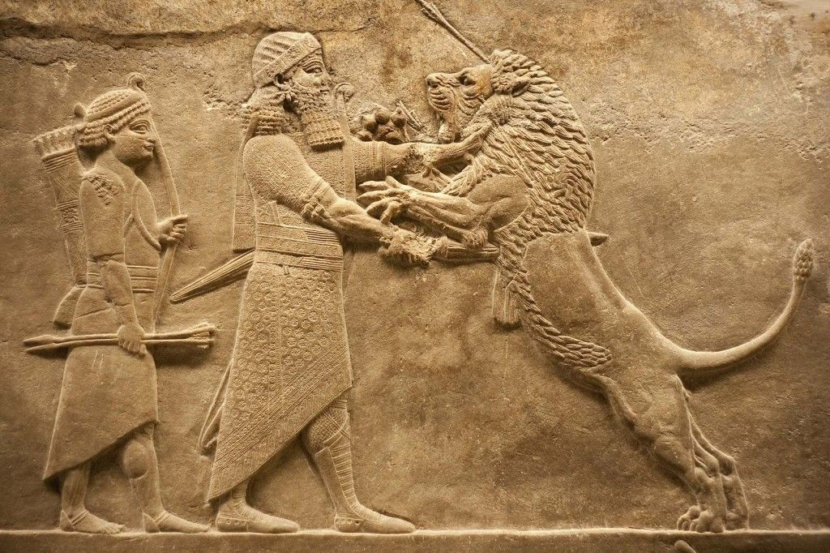
There are universal stories
There are universal stories
THERE ARE UNIVERSAL STORIES
THERE ARE UNIVERSAL CHARACTERS
هنالك قصص وشخصيات عالمية
There are universal characters

Slide 4
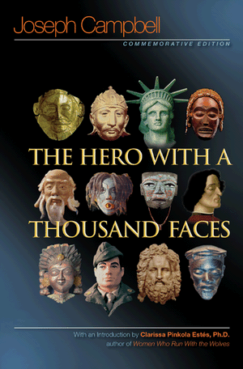
jOSEPH CAMPBELL
The theory of the Monomyth
And Archetypal characters

Slide 5
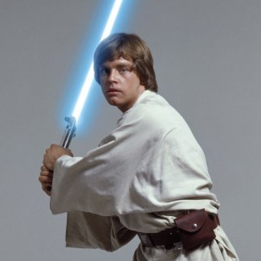
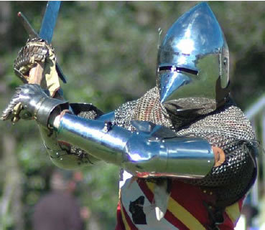
George Lucas rewrote Star Wars after reading Joseph Campbell
جورج لوكاس أعاد كتابة "ستار وارس" بعد قراءة جوزيف كامبل

Slide 6
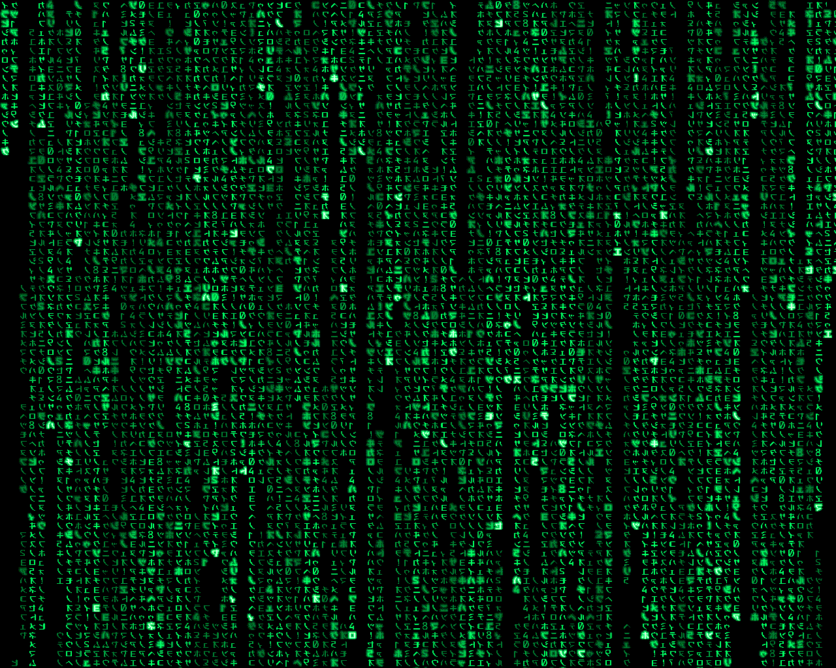
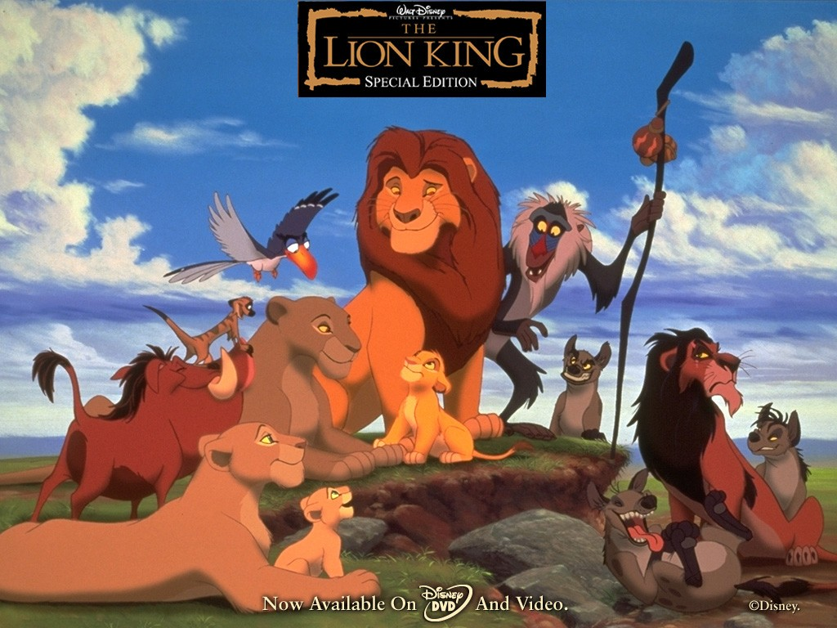
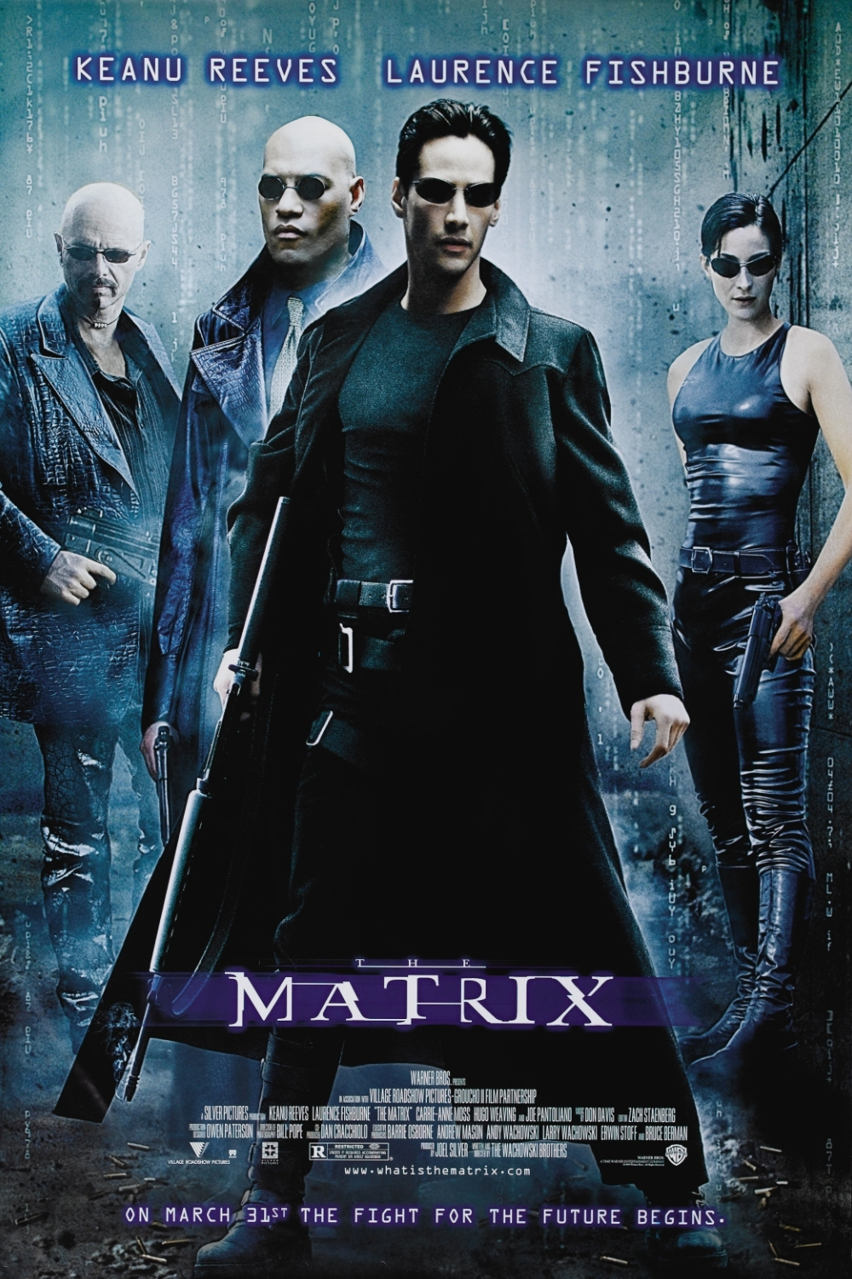
Other stories that pay tribute to Joseph Campbell
المزيد من القصص التي أعربت عن تقديرها لجوزيف كامبل

Slide 7
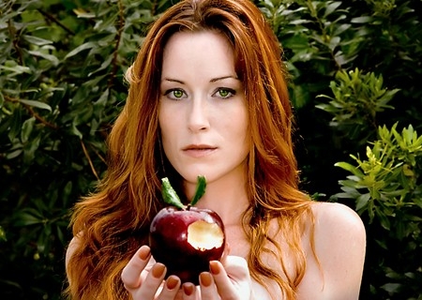
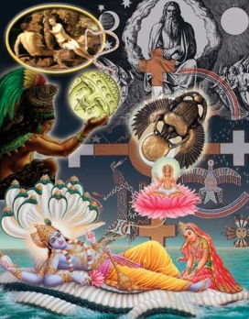
Archetype – ‘Original Form’
“A recurrent universal pattern or motif holding the same similar meaning and significance for all individuals in ever age and in every part of the world” (Watson and Ducharme)
نمط أو نموذج عالمي متكرر يحمل نفس المعنى والأهمية المتشابهة لجميع الأفراد في أي عمر وفي كل جزء من العالم "(واتسون ودوشارم)
Notes:
The universal symbols, theme, characters and images we find repeated throughout literature
“A recurrent, universal pattern or motif holding the same or similar meaning and significance for all individuals in every age and in every part of the world. ” (Watson and Ducharme)

Slide 8
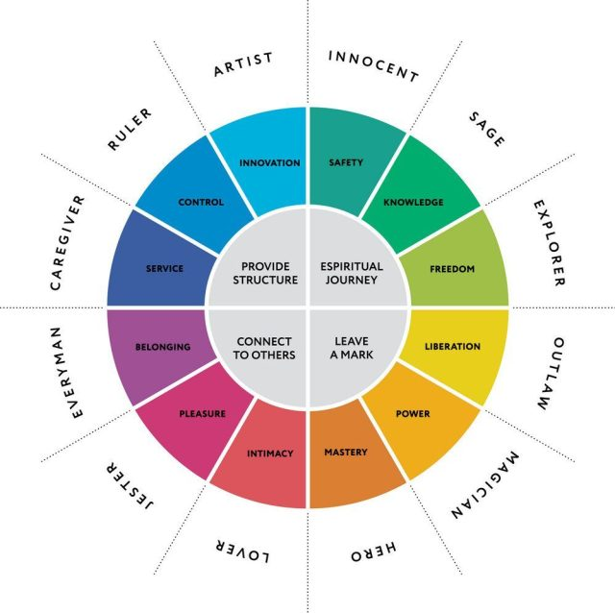
12 Archetypal Characters
All are shared across cultures
All reside within us and are
Active to various degrees
Archetypes are a broad
universal template of human
needs and desires.
كلها مشتركة عبر الثقافات، جميعها تقيم في
داخلنا وهي كذلك فعالة بدرجات مختلفة.
النماذج الأولية واسعة وهي قالب عالمي
لإحتياجات وشغف الإنسان.

Slide 9
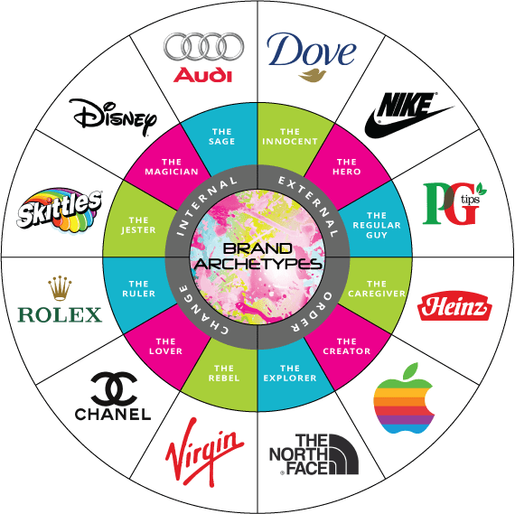
Brand Archetypes
Brands use archetypes to connect
With your deepest needs and desires
Brands that associate themselves with
A single archetype are more successful
تستخدم العلامات التجارية النماذج الأولية
للتواصل مع أعمق إحتياجاتك ورغباتك.
العلامات التجارية التي تربط نفسها
في نموذج أولي واحد، تكون أكثر نجاحًا

Slide 10
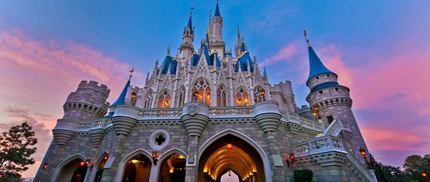
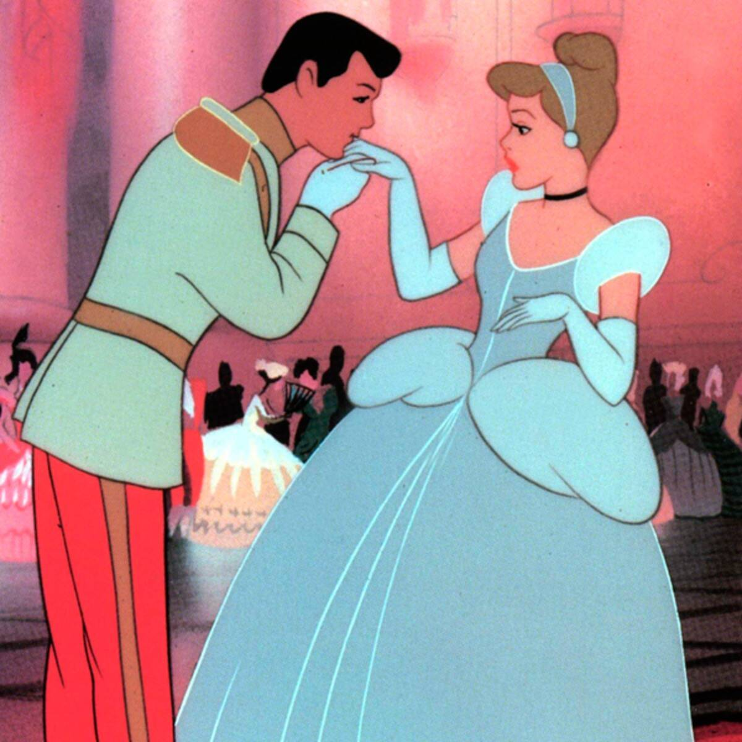
A GOOD STORY IS TIMELESS AND CROSSES CULTURES
ما يجعل القصة جيدة هي أن تكون خالدة وتقطع الثقافات
CINDERELLA - PRETTY WOMAN – ’RAGS TO RICHES’

Slide 11
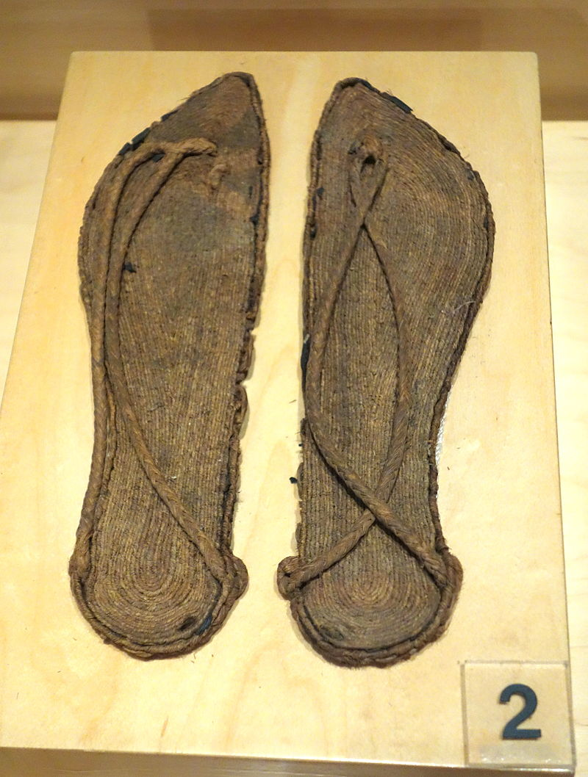
A GOOD STORY IS TIMELESS AND CROSSES CULTURES
Ancient Greece –
‘Rodopis’ and the eagle
Dropping a slipper
Malta – ‘Ciklemfusa’
Over 345 Different
Variations of ‘Cinderella’
Have been Identified
China – ‘Ye Xian’
Japan – ‘Sumiyoshi Monogatari’
1001 Nights
The Second Shaykh’s story
The eldest Lady’s Tale
Abdallah ibn Fadil
Iran – ‘Moon Brow’
France – ‘La Fresne’
Vietnam – ‘Tam and Cam’
Vietnam – Tam and Cam

Slide 12
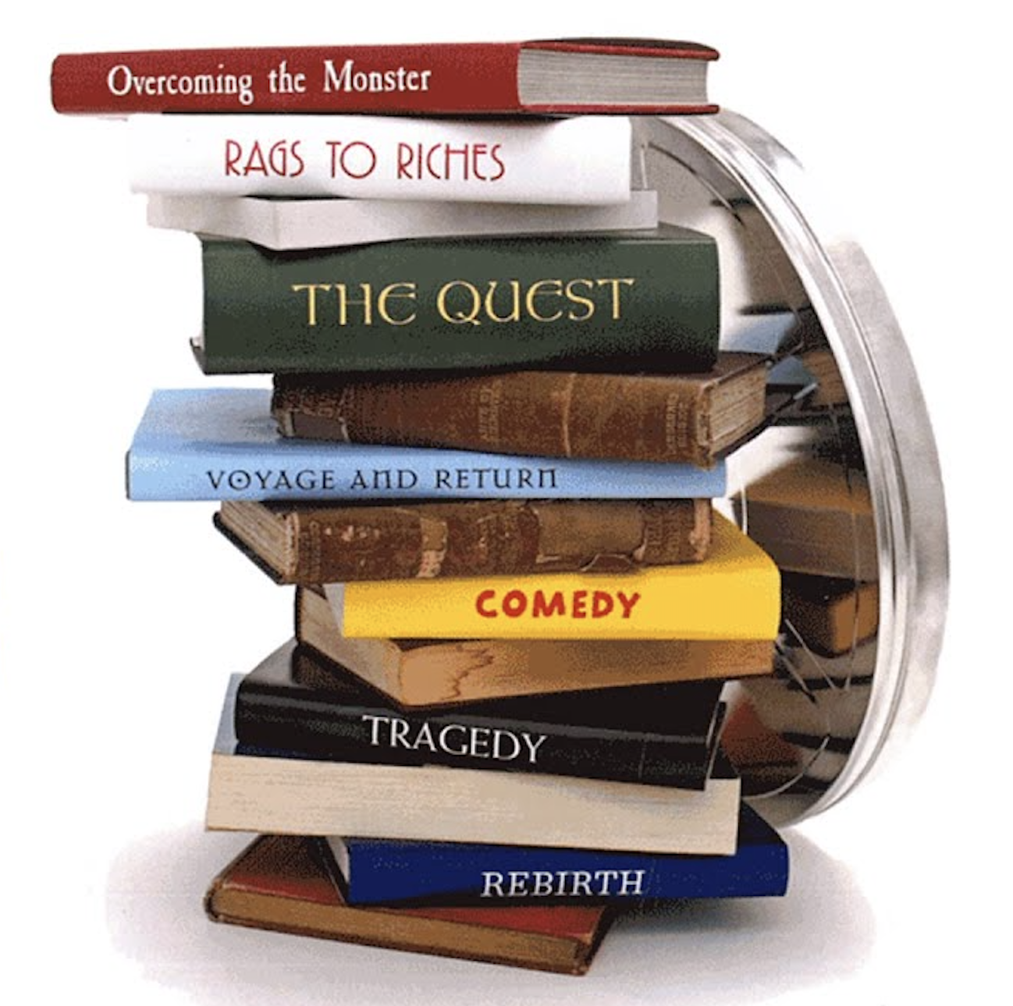
SEVEN PLOTS?
سبع حبكات
OVERCOMING THE MONSTER - - Beowulf, War of the Worlds
التغلب على الوحش
RAGS TO RICHES - Cinderella , Jane Eyre, Pretty Woman
خِرق قماش وحتى ثراء
THE QUEST- The Odyssey, Lord of the Rings, Star Wars, Serial
البحث
VOYAGE AND RETURN - Alice in Wonderland , Toy Story,
Where the Wild Things Are, The Little Prince
الرحلة والعودة
REBIRTH - Sleeping Beauty, A Christmas Carol, The Shawshank Redemption
الولادة من جديد
COMEDY - A Midsummer Night’s Dream , Four Weddings and a Funeral
فكاهة، كوميديا
TRAGEDTY - Hamlet, The Godfather
مأساة، تراجيدية

Slide 13
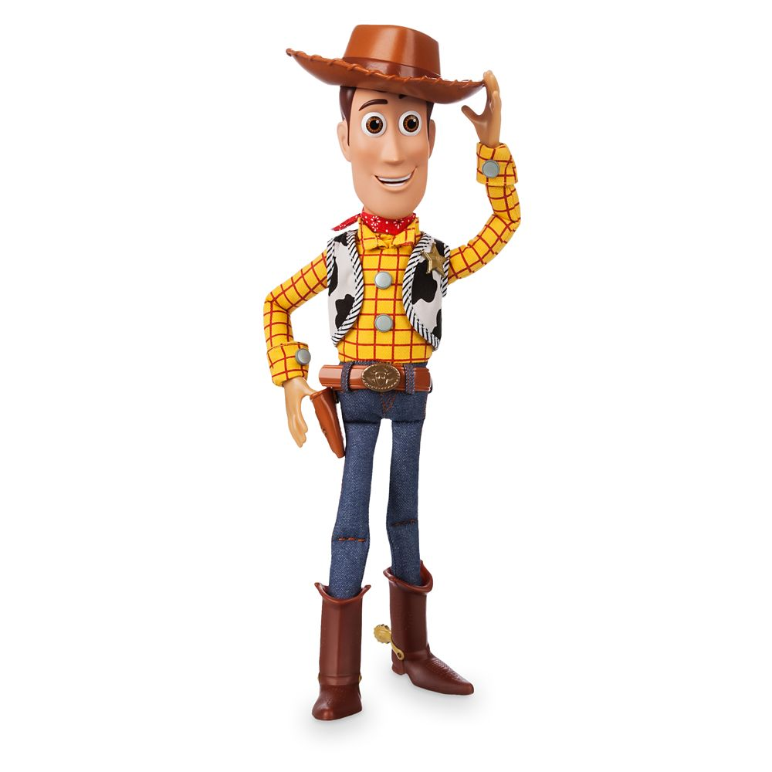
PIXAR STORY STRUCTURE

Slide 14
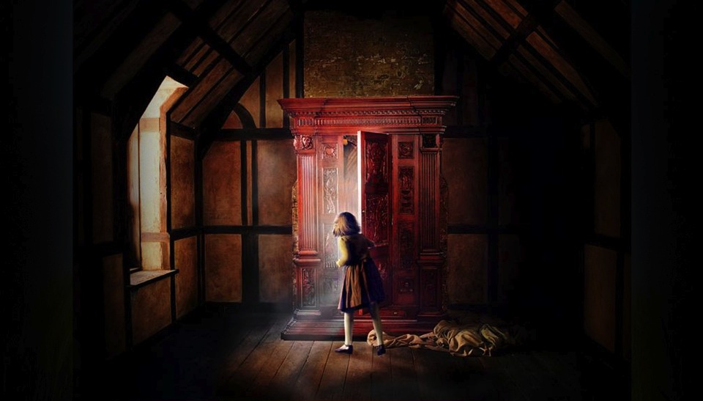
CHARACTER(S)
INCITING
INCIDENT
MOTIVE
CONTEXT
PROTAGONISTS
VS ANTAGONISTs
STRUGGLE
PLOT
LESSON

Slide 15
INCITING INCIDENT
I Where does your story start? What sets it off?
CHARACTER
Who are you appealing to? What will they identify with? Which characters
Are you interacting with? Who is with ? Who is against you? (Antagonists vs Protagonist)
CONTEXT
What kind of a world is your story taking place in ?
MOTIVE
Your big ‘Why?’. What are you doing this for? What is driving you? What are your goals? What are you aiming for? Sfless - Making a better world for generations to come
STRUGGLE
What or who is trying to stop you reaching your goals? What and who you are fighting for shows what and who you are fighting against

Slide 16
A FEW TIPS FROM STORYTELLING WISDOM
Make the story your own – be authentic
Don’t be afraid of the negatives… people want to hear how you overcame them or turned them round
Failure makes you human
People love the ‘Underdog’…not the ‘Overdog’
Think in opposites – positive and negative- what you are for is what you are also against
Your world and your struggles can be internal as much as external

Slide 17
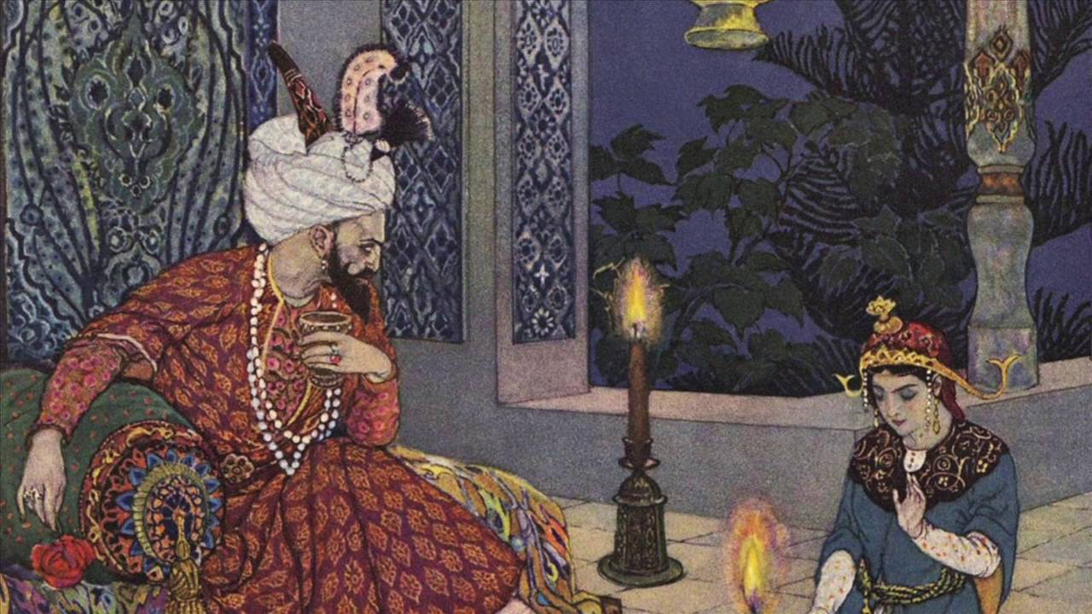
Further Reading
قراءة إضافية

Slide 18
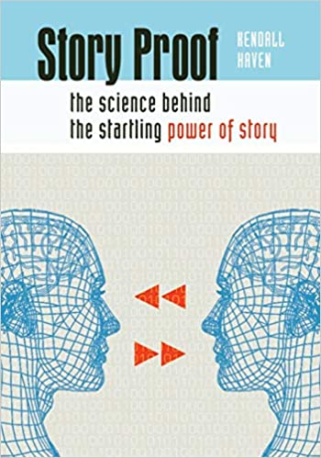
Story Proof - The science behind the startling power of story Haven, Kendall , 2007
Libraries Unlimited Inc. , ISBN10 1591585465. ISBN13 9781591585466
Story Smart – Using the science of story to persuade, influence inspire and teach – Haven, Kendall 2014,
Libraries Unlimited (ISBN: 9781610698115)
The science…
…and how to apply it

Slide 19
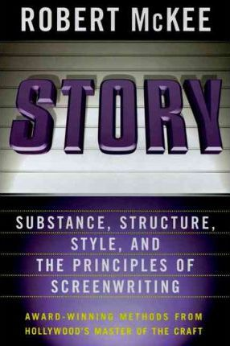
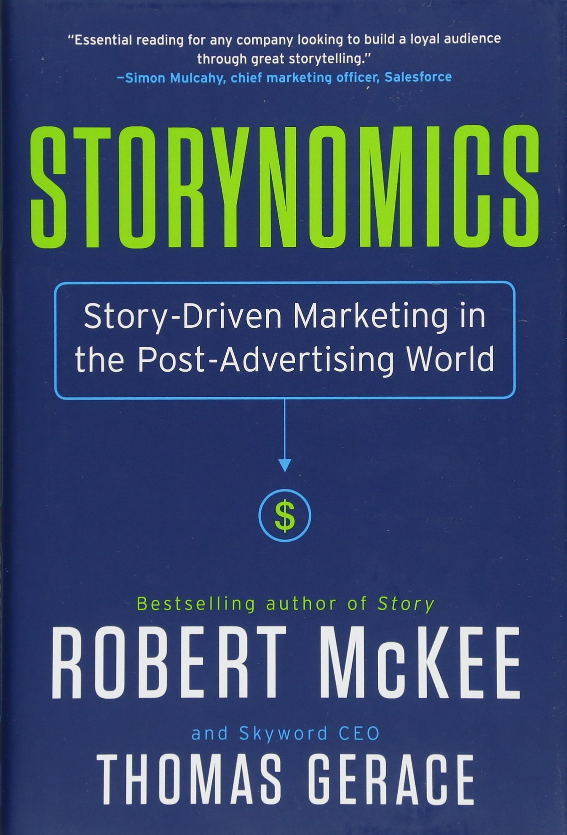
Hollywood theory for screen and business
Story: Substance, Structure, Style, and the Principles of Screenwriting, Mckee, Robert
June 2011, Harper Collins (ISBN10 0060391685, ISBN13 9780060391683)
Storynomics Story Driven marketing in a post advertising world, McKee, Robert March 2018,
Hachette USA (ISBN-10: 1538727935ISBN-13: 978-1538727935)

Slide 20
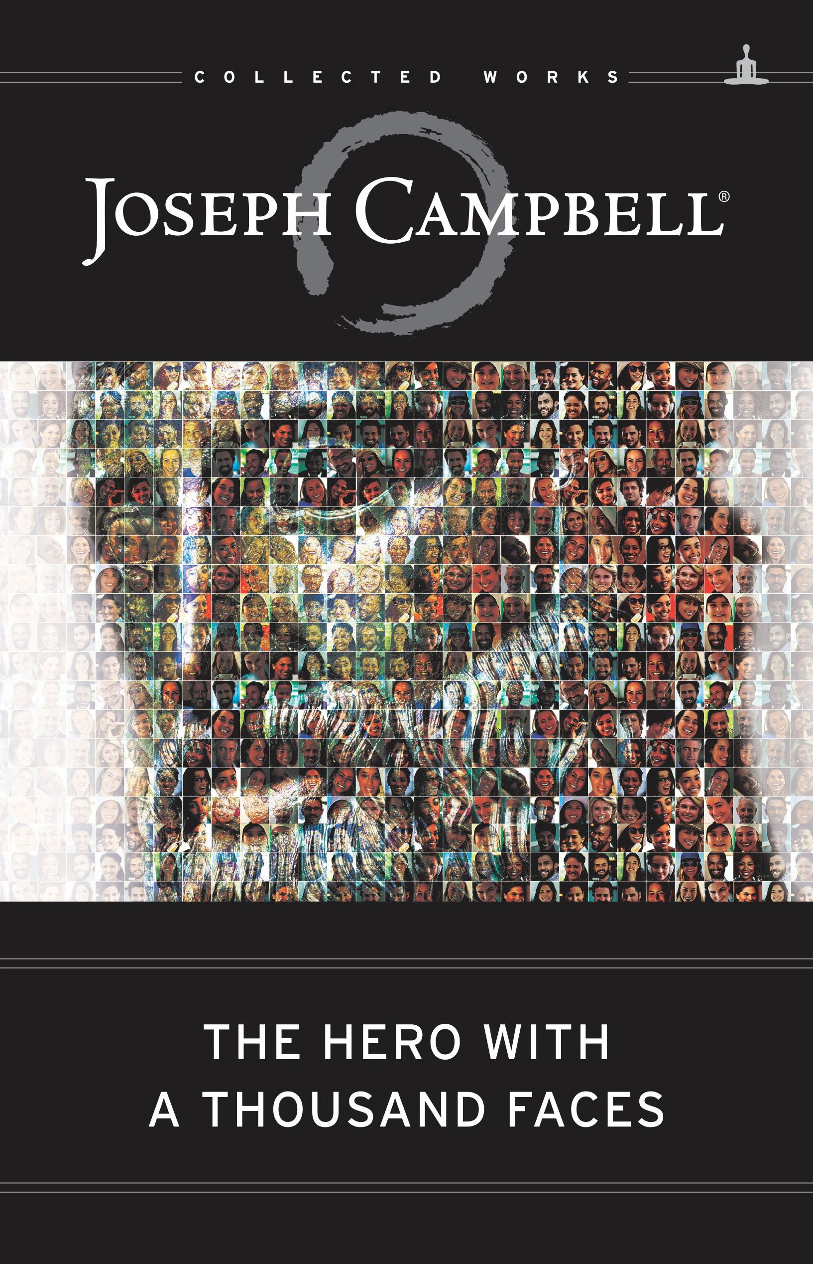
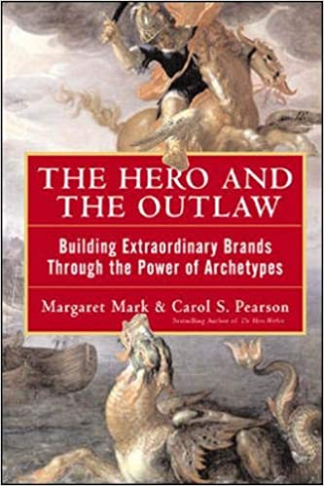
Archetypes in Mythology, Psychology and Advertising
The Hero with A Thousand Faces (The Collected Works of Joseph Campbell) Campbell, Joseph
New World Library; 3rd edition (23 April 2012) ISBN-10: 1577315936, ISBN-13: 978-1577315933
The Hero and the outlaw – building
extraordinary brands through the power of archetypes Mark Margaret and
Pearson , Carol , February 2001 McGraw Hill Education , ISBN-10: 0071364153, ISBN-13: 978-0071364157
…

